Slide 1
Network Project
Wesley wienand
217047856
CSC02B2

Slide 2
Network Project
Problem being faced that is relevant to the 4th Industrial revolution
Solution for problem being faced
Methodology

Slide 3
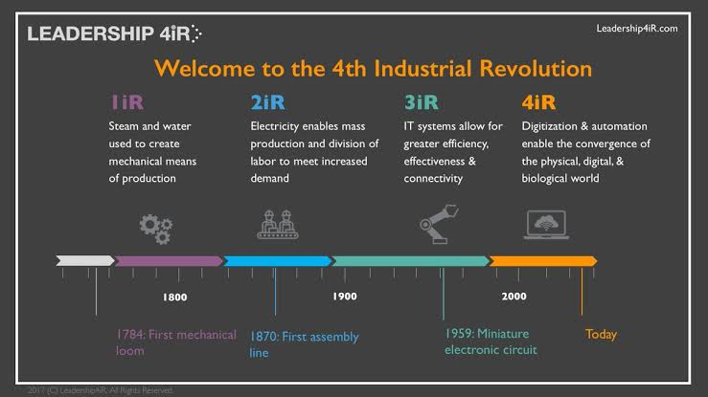
The Industrial Revolutions timeline

Slide 4
Problem being faced
Threats to transparency and accountability.
In the recent years ‘Fake’ news has highlighted a lack of transparency and accountability as people can manipulate millions of people into believing news that is not legitimate.
People in todays time have the ability to write as bloggers and gather a following, websites that are fraudulent can be created at anytime and anywhere, it has never been easier to reach a high amount of people in a short time.
In todays time even machine learning systems are unable to reveal how it’s algorithm comes to a final decision when detecting ‘Fake’ news online.
The question at hand is who will be held accountable for the harm fake news does to society and how does the misconception get fixed?

Slide 5
Solution
Gather data
Collect all online newsfeeds
Process Data
Process image source data and detect fraudulent edited images.
Return data
Only return verified legitimate image sources
I have created a Java application that interfaces with a Web API where image processing can be done on multiple layers.
Image filters can be applied to the image as well as cropping the image and rotating the image.

Slide 6
Methodology
I first started to break down the network project to understand what needed to be accomplished.
After knowing what needed to be done for the project I went to go and research the 4th industrial revolution and problems faced.
Knowing the problem I wanted to face I started my approach by developing an image editing tool with Java.
Once I was finished developing the image editing tool I went back to evaluate if I had solved the problem I was faced with.
I collected data off the internet, Image sources off the interned.
I chose image sources off the internet as a working platform as it had a direct relation to the problem of fraudulent image sources on the internet.

Slide 7
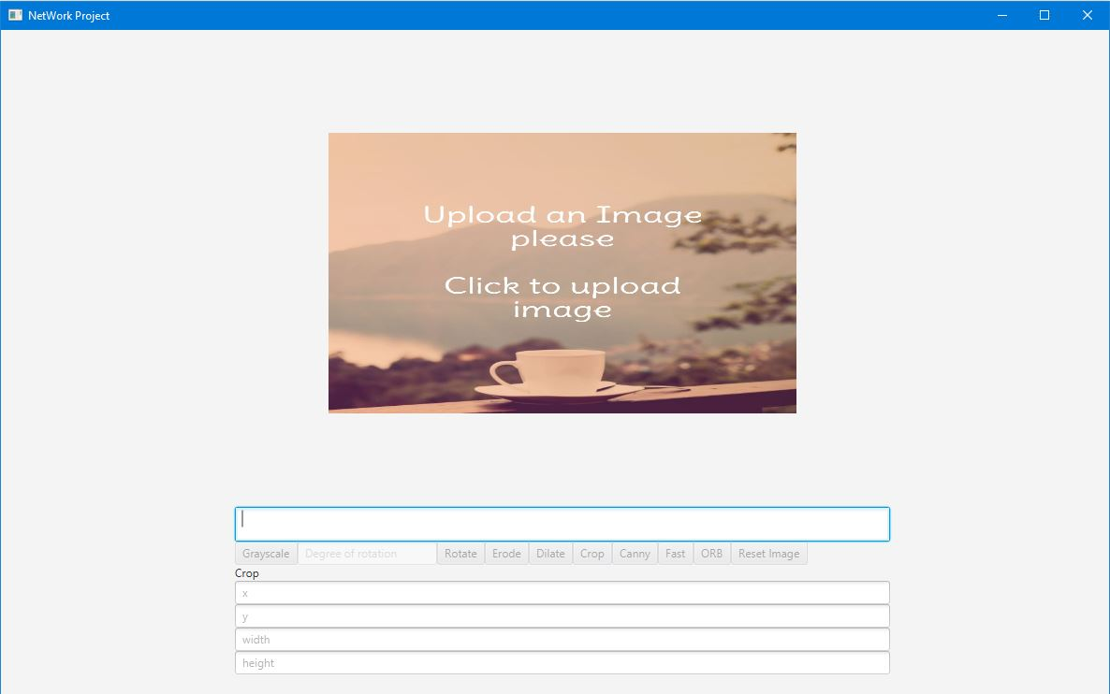

Slide 8
References
Groscurth, C. (2019). 4th Industrial revolution timeline. [online] Encrypted-tbn0.gstatic.com. Available at: https://encrypted-tbn0.gstatic.com/images?q=tbn%3AANd9GcRj3UmyF0svNV6f_zVTnkf1IpcCXw8_5ZAqBONAc8NDx00dBzTF [Accessed 27 Oct. 2019].
World Economic Forum. (2019). 5 challenges for civil society in the Fourth Industrial Revolution. [online] Available at: https://www.weforum.org/agenda/2017/12/5-challenges-facing-civil-society-in-the-fourth-industrial-revolution/ [Accessed 26 Oct. 2019].
Scribbr. (2019). How to Write Research Methodology in Four Steps | With Examples. [online] Available at: https://www.scribbr.com/dissertation/methodology/ [Accessed 27 Oct. 2019].
Writer, G. (2019). Five Problems with the Fourth Industrial Revolution - ICTworks. [online] ICTworks. Available at: https://www.ictworks.org/problems-fourth-industrial-revolution/#.XbfzEXhR2Cg [Accessed 24 Oct. 2019].

Slide 9
THE END

